Slide 1
ANALYZING REAL ESTATE INVESTEMENTS IN THE UNITED STATES
GROUP VII

Slide 2
Business Problem
The project seeks to identify the most advantageous zip code regions for American Properties Corporation's investment, underlining the significance of choosing areas with strong growth potential to optimize returns.

Slide 3
Project Objectives
Define criteria for evaluating “BEST" investment zipcodes.
Uncover key patterns, trends, and relationships within the data.
Develop predictive time series model to forecast real estate prices per zipcode
Provide investment recommendations.

Slide 4
Data Understanding
Dataframe Structure
Data types:
Missing values present in 220 columns
Dataset consumes : 30.6 megabytes of memory
No duplicates were identified in any of the columns
Columns:
14,722 rows
272 columns
RegionID,
RegionName,
State,
City,
Metro,
SizeRank
CountyName,
The rest are dates
219 : float columns.
49 : integer columns.
4 : object columns.

Slide 5
Data Cleaning
Extracting the datetimes in the columns.
Removing redundant columns. ie RegionID
Detecting and addressing missing values.
Renaming "RegionName" to "Zipcode"
Change categorical column datatypes to string.

Slide 6
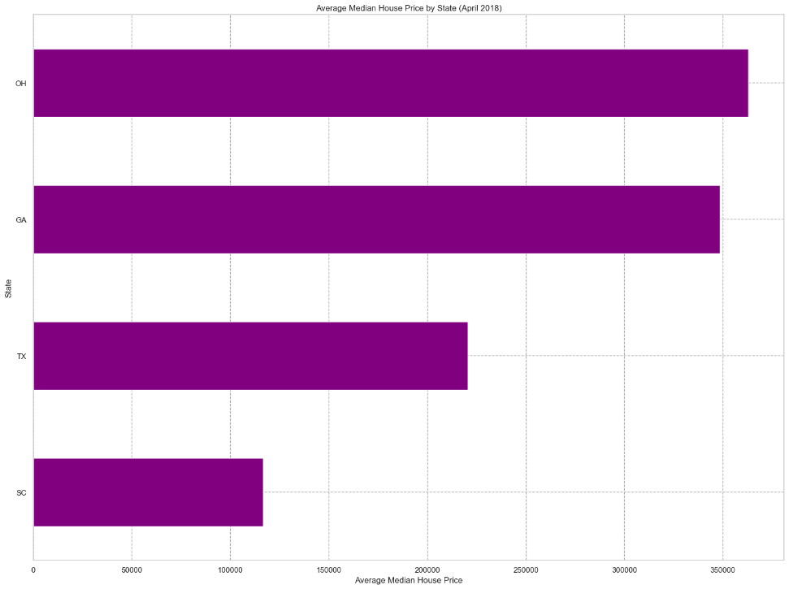
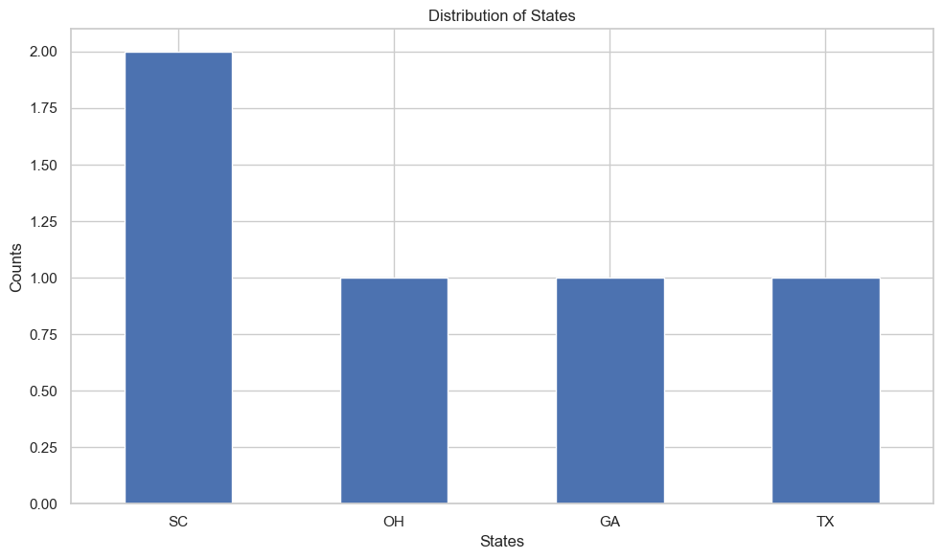
Exploratory Data Analysis
The distribution of states is based on our best 5 zipcodes

Slide 7
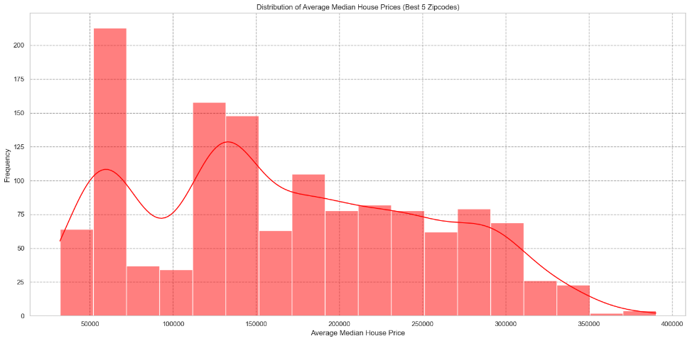
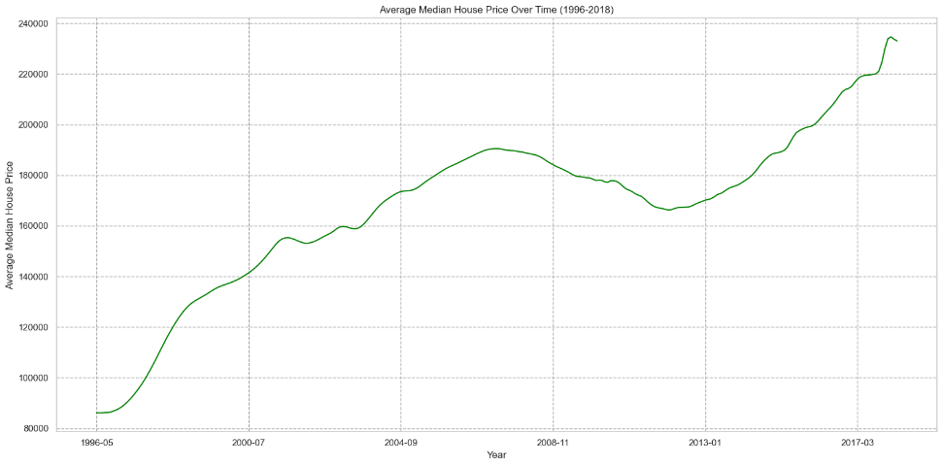
Exploratory Data Analysis

Slide 8
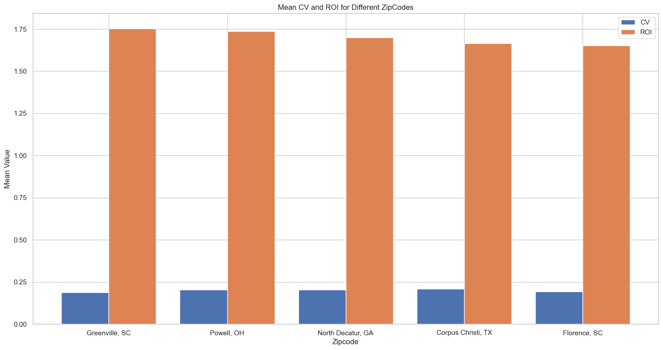
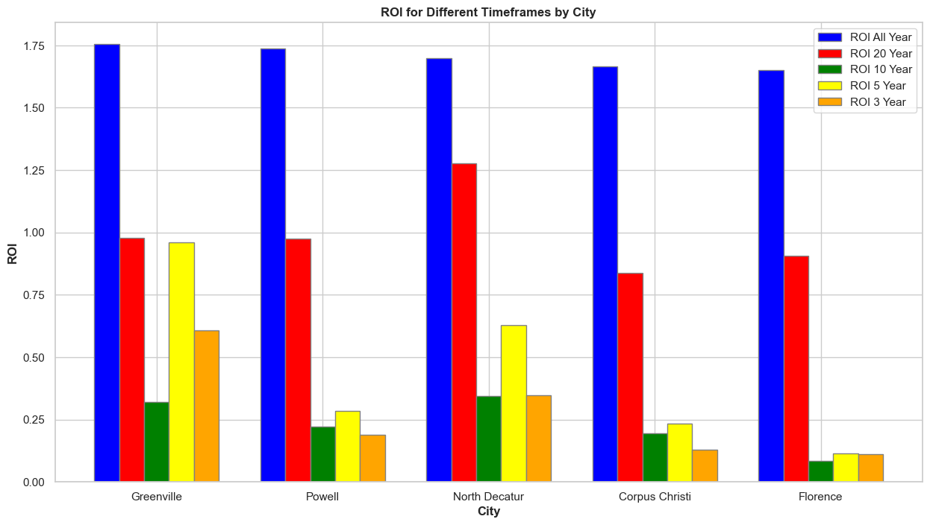
Exploratory Data Analysis

Slide 9
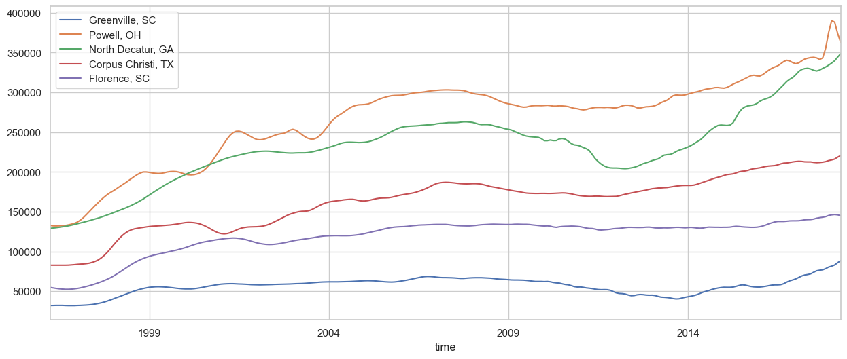
Time Series Modelling
Property value per each Zip code over time

Slide 10
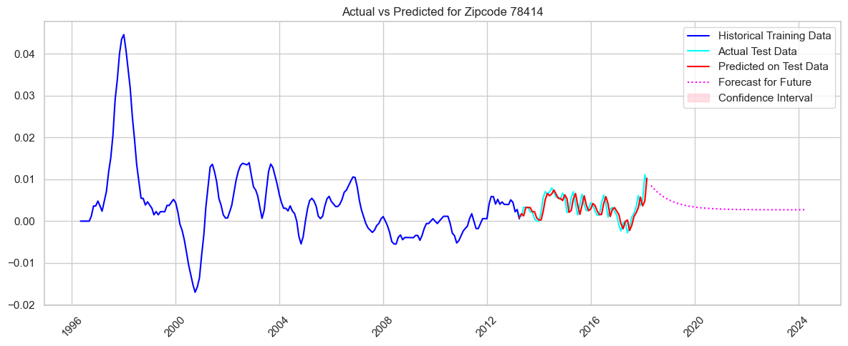
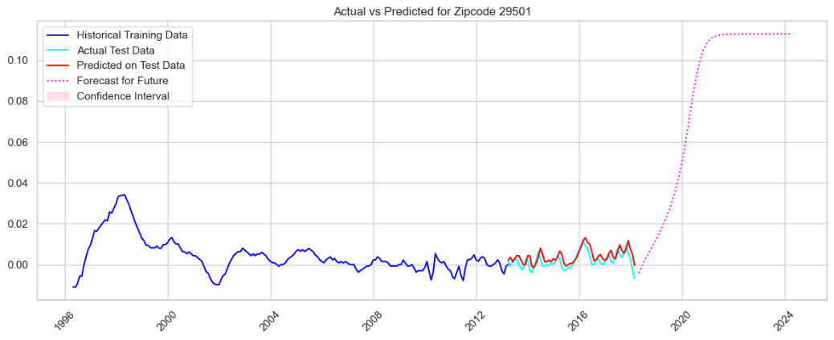
Future Forecasting
Stable predictions using best model (LSTM)

Slide 11
Conclusion
The LSTM model demonstrated strong predictive performance, outperforming the other models in terms of lower variation with the model's strengths evident in capturing non-linear trends and abrupt changes.

Slide 12
Recommendations
Diversifying the investment portfolio across multiple states
Investments can be focused on cities with higher ROI
Greenville, SC
North Decatur, GA
Powell, OH
Good investment portfolio should balance ROI with risk
GreenVille, SC has the lowest risk.
Property value trends
Ohio has higher value property while S.Carolina has relatively lower prices which may be more attractive.
Long term growth
Consider North Decature with highest ROI in 22yr period.

Slide 13
Next Steps
Location matters in the investment portfolio consider:
City unique characteristics
Development prospects
Economic growth
Consider other features that may influence ROI in the real estate:
Interest rates
Economic downtime
Policy changes
Create a system that ensures the model responds to market dynamics in real time.

